Slide 1
Demura FW development flow V1.0
2024-12-18

Slide 2
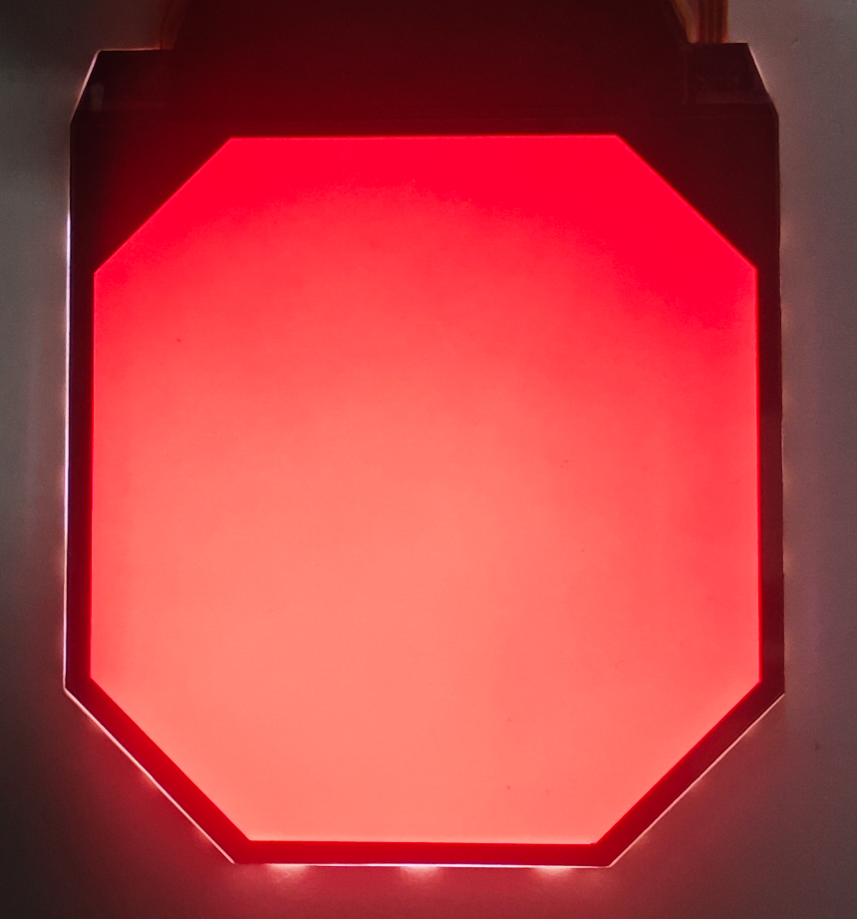

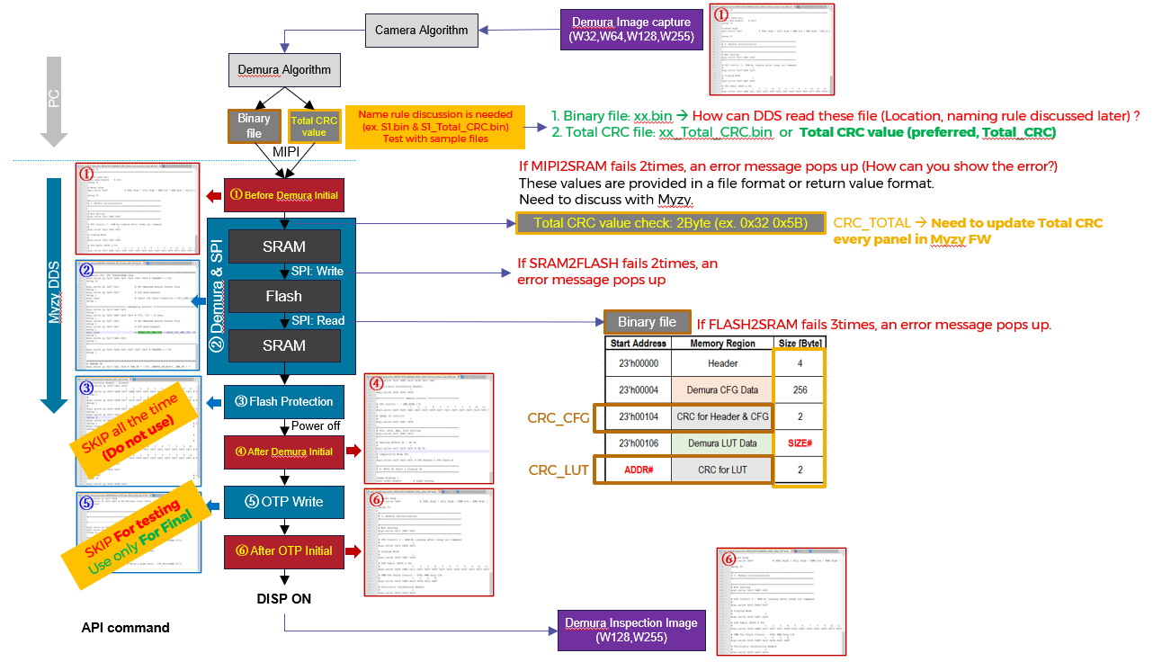
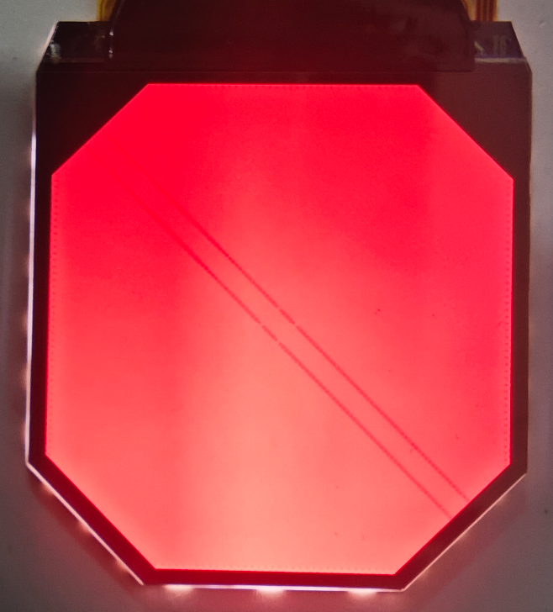
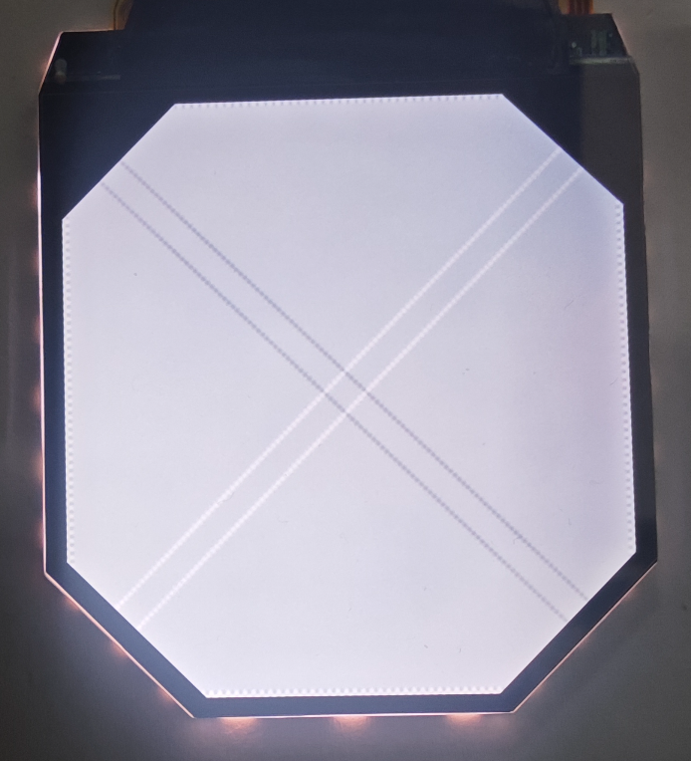
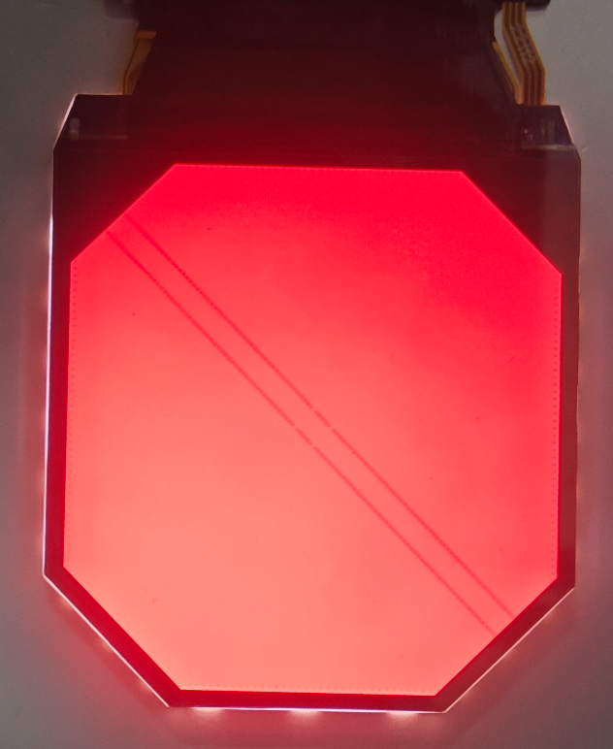
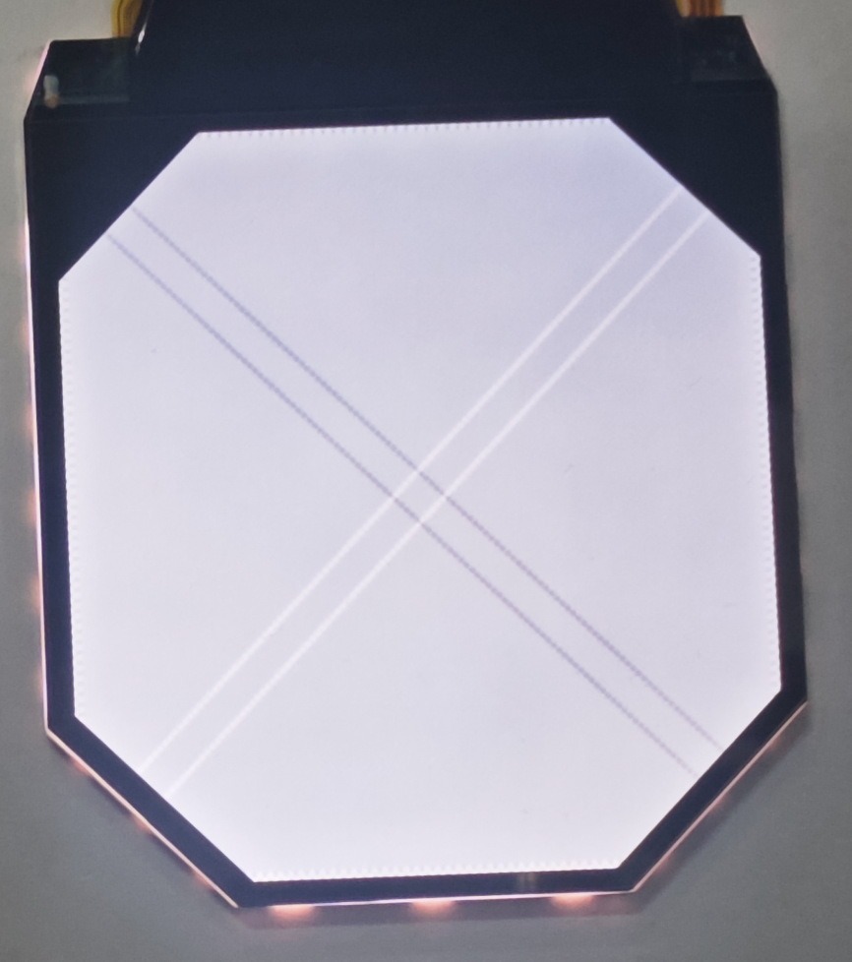
Function
R255
W128
Before
Demura
After
Demura
After
OTP

Slide 3
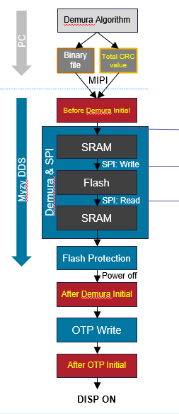
Function
int LoadDemuraFile(char* bin_path, unsigned char *crc_value);
int DemuraMode(int mode);
int BeforeDemuraPowerOn();
Error code：
E001-0001:SRamWrite Error
E002-0001:FlashWrite Error
E003-0001:FlashLoad Error
int DemuraWrite();
int DemuraProtection(int mode);
int AfterDemuraPowerOn();
int DemuraOTP();
First Version: Segundo_Demura_V1.0.0_20241218

Slide 4
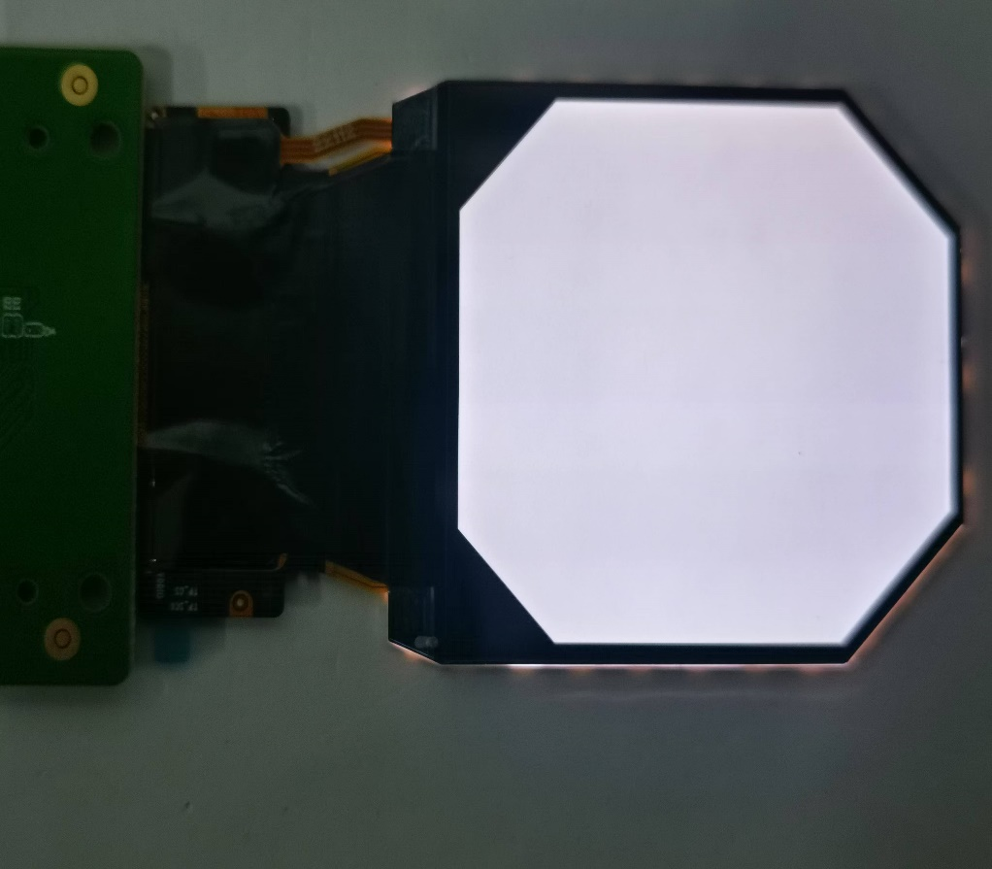
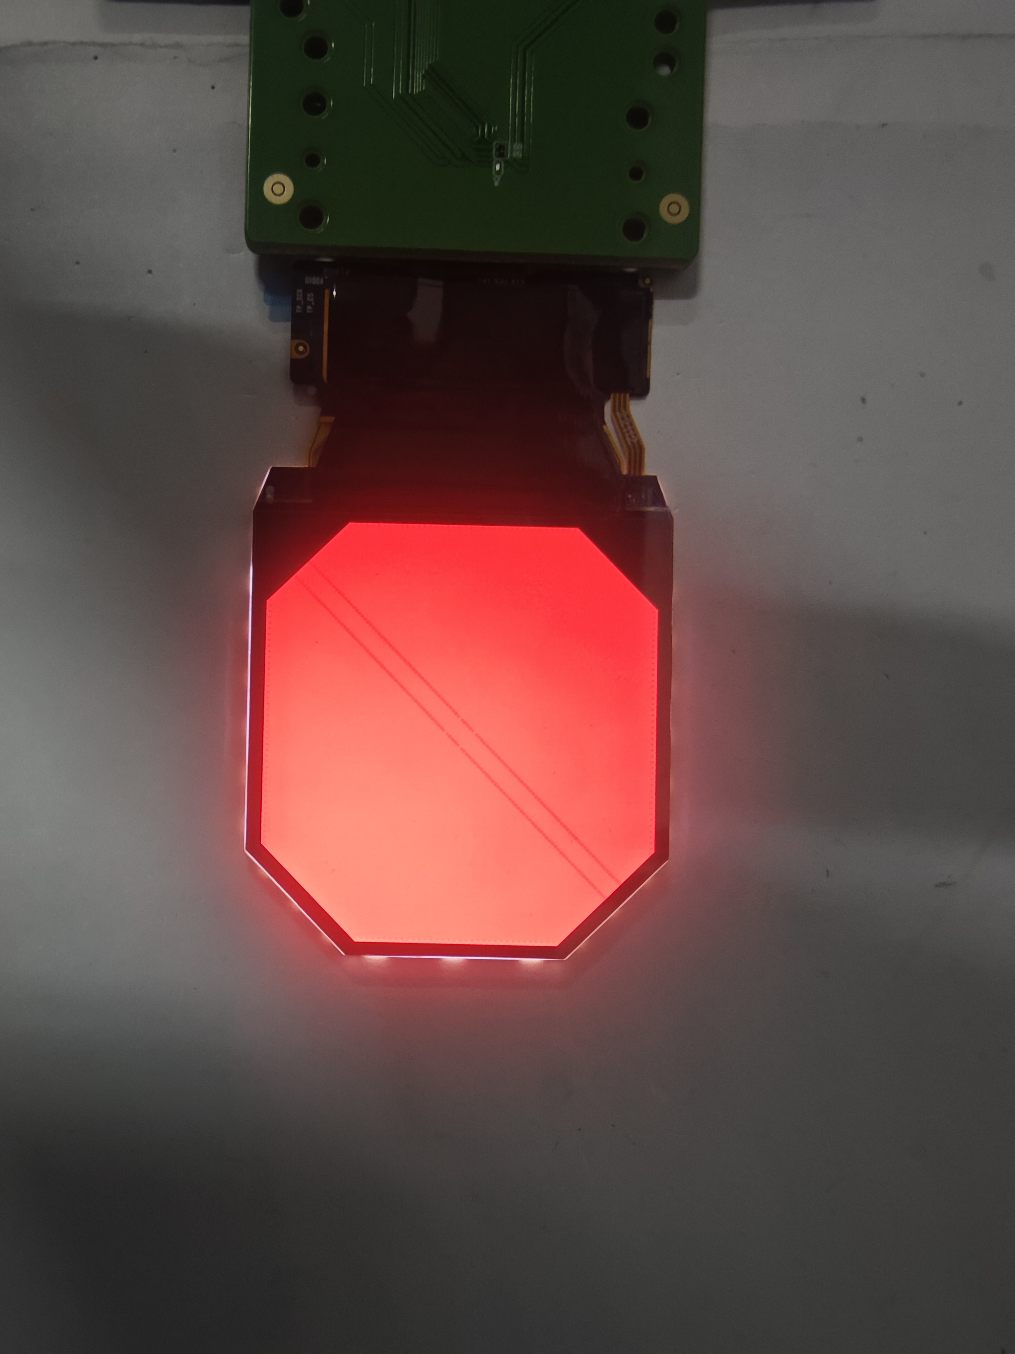
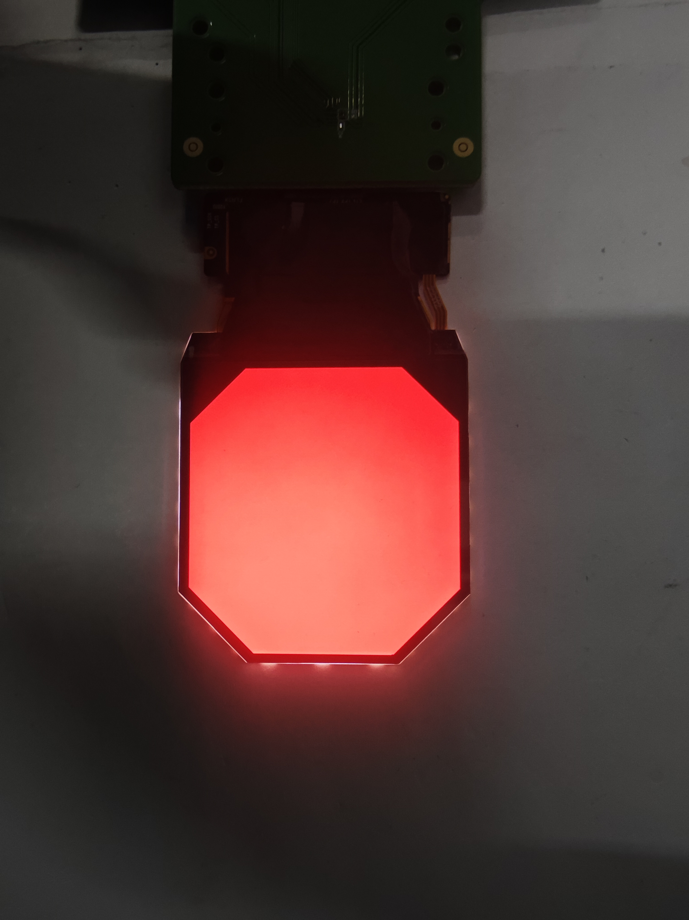
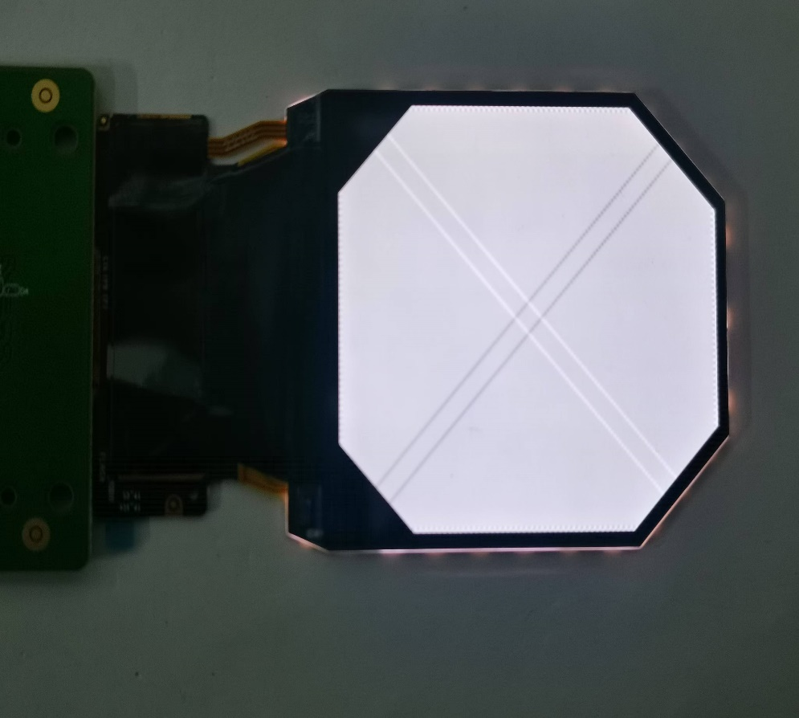
Helios POR FW
Helios POR FW: Segundo_P1_2_V1.0.6_ERS_01.G_20241218
Normal Helios Panel
After Demura&OTP Helios Panel

Slide 5
THANKS

